Slide 1

AI Ethics for Beginners
Navigating the New Frontier of Intelligence: A Guide to Building a Fairer, Smarter World.

Slide 2
Why Does Ethics Matter?
Moving from "Can we build it?" to "Should we build it?"

Slide 3

CORE PILLAR: FAIRNESS & BIAS
What is Algorithm Bias?
The Fairness Challenge
AI learns from human data. If that data contains historical prejudices, the AI doesn't just learn them—it automates and scales them.
Ensuring that AI treats all individuals equally, regardless of race, gender, or background, is the primary goal of ethical development.

Slide 4

TRANSPARENCY
The "Black Box" Problem
Many modern AI models are so complex that even their creators can't explain exactly why a specific decision was made.
Transparency is about building "Explainable AI" that humans can trust and audit for safety.

Slide 5





FOUNDATIONS OF DATA PRIVACY
Consent
Security
Anonymity
Users must know what data is being collected and how it is used by AI systems.
Protecting data from breaches is essential to prevent misuse of personal identities.
AI should process insights from patterns, not from identifiable personal lives.

Slide 6
THE SCALE OF THE PROBLEM
85%
A Global Priority
Gartner predicts that by 2025, 85% of AI projects will deliver erroneous outcomes due to bias in data or algorithms. Ethics is no longer a luxury; it is a technical necessity.
Predicted Bias Risk

Slide 7
AI Ethics in Action
Real-world dilemmas that redefined our approach.

Slide 8

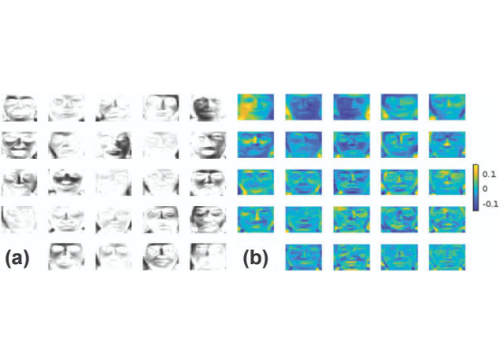
FACIAL RECOGNITION RISKS
Training Data Gaps
When facial recognition AI is trained on non-diverse datasets, its accuracy drops significantly for underrepresented groups.
This leads to dangerous misidentifications in law enforcement and surveillance, raising profound civil liberty concerns.

Slide 9
PRINCIPLES OF RESPONSIBLE AI
Accountability: Clear legal and moral responsibility must be assigned for AI actions.
Human Safety: AI should never be deployed in ways that threaten physical or psychological harm.
Human Oversight: Humans should always have the final "kill switch" in high-stakes decisions.

Slide 10
THE POLICY LANDSCAPE
GDPR Era
AI Ethics Guidelines
EU AI Act
Global Accord
Early focus on data privacy and the 'right to an explanation' for users.
Major tech firms and nations release "Principles" for ethical development.
The world's first comprehensive law to regulate AI based on risk levels.
Moving toward international standards for safe and benevolent AI.

Slide 11
"Ethics is not a bolt-on feature for AI; it is the very foundation upon which intelligent systems must be built to serve humanity."
— Responsible AI Initiative

Slide 12
Join the Conversation
The future of AI is not something that happens to us—it is something we build together.
Contact Us: ethics@aisociety.org
Learn More: www.futureofethics.ai

Slide 13


IMAGE SOURCES
https://img.freepik.com/premium-vector/digital-eye-data-network-cyber-security-technology-vector-background-futuristic-tech-virtual-cyberspace-internet-secure-surveillance-binary-code-digital-eye-safety-scanner_8071-7138.jpg?w=360
Source: www.freepik.com
https://www.siam.org/media/0vxjvhl3/figure1.jpg
Source: www.siam.org

